Slide 1

HOPKINS STATISTIC
introduced by Brian Hopkins and John Gordon Skellam in 1990

Slide 2
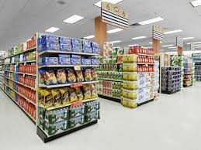

What is Hopkins Statistic?
Hopkins Statistics is used to evaluate the tendency of clustering in a data.
dividing the dataset into groups
Eg. Items arranged in a mall
Eg. Men,Women,Kids section

Slide 3
Steps involved in clustering :
1.) Data Preprocessing - Though clustering is also a part of Exploratory Data Analysis (EDA), the initial data preprocessing steps should be performed like removing null values, outliers etc.
2.) Evaluate Clustering tendency - Check if the data will be able to perform clustering. If yes, we can proceed with clustering. If no, more data will be required or data should be reprocessed or the solution will not be qualitative.
3.) Clustering Algorithm - Apply clustering algorithms to create optimum number of clusters.

Slide 4

NOTE : One should be very careful while applying clustering because the algorithm will cluster the data no matter if clustering is possible or no. So the most important step in clustering is to evaluate the clustering tendency.
Hence, we use Hopkins Statistic in order to see if the dataset if feasible for clustering or not.

Slide 5

Formula of Hopkins Statistic:
ui = Distance between original data and sample data
wi = Distance between artificial data and original data

Slide 6
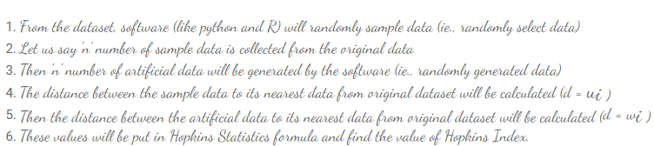
How Hopkins Statistics works?

Slide 7
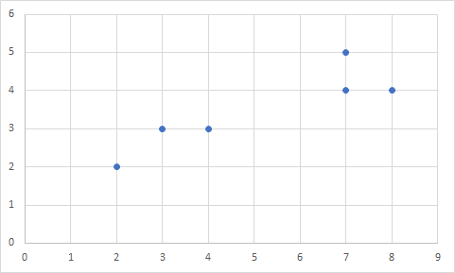
Demo of Hopkins Statistics Working:
STEP 1:
Say we have a dataset (D)- [(2,2), (3,3), (4,3), (7,5), (7,4), (8,4)]

Slide 8
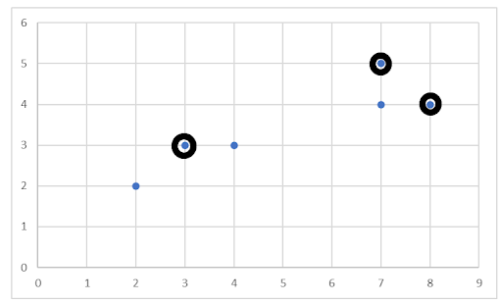
STEP 2 :
A sample is taken from dataset D - [(3,3), (7,5), (8,4)]
(7,5)
(8,4)
(3,3)

Slide 9
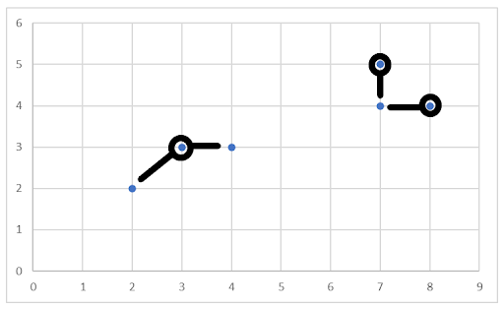

STEP 3 :
The distance between the sample data to its nearest neighbor data from original dataset D is calculated.
The distance from (3,3) to (2,2) and (4,3) is calculated, distance from (7,5) to (7,4) and from (8,4) to (7,4) is calculated and summed up (∑u_{i}.)
(7,5)
(8,4)
(3,3)
(4,3)
(7,4)
(2,2)
Distance is calculated using
Euclidean distance formula:

Slide 10
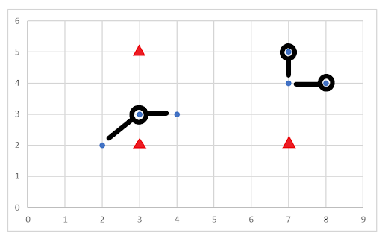
STEP 4 :
It was said that software generates an artificial data randomly. Since, we have taken three sample data, there should be three artificial data points (these points are randomly generated by machine)
randomly generated artificial points

Slide 11
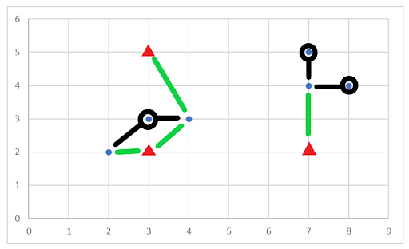
STEP 5 :
The distance between the artificial data to its nearest neighbor data from original dataset D is calculated.
The green color represents the distance from artificial data to original data and then these green colored distances are summed up (∑wi.)

Slide 12

STEP 6 :
Now finally Hopkins Formula is used.

Slide 13
Hypothesis of Hopkins Statistics:
_{Null Hypothesis :}
The data set is uniformly distributed (meaning no meaningful cluster is possible)
_{Alternative Hypothesis :}
The data set is not uniformly distributed (meaning there can be a meaningful clusters)

Slide 14
NOTE:
IF HOPKINS VALUE <= 0.5 THEN GOOD CLUSTERING (CLUSTERS HAS MEANING)
REJECT NULL HYPOTHESIS
IF HOPKINS VALUE > 0.5 THEN NO MEANINGFUL CLUSTERS
ACCEPT NULL HYPOTHESIS

Slide 15
References:
https://datasciencewithlearner.blogspot.com/2021/11/hopkins-statistics-in-clustering.html - Tejaswini’s Blog
https://www.kaggle.com/lachhebo/hopkins-test - Hopkins coding
https://en.wikipedia.org/wiki/Hopkins_statistic - Wikipedia

Slide 16
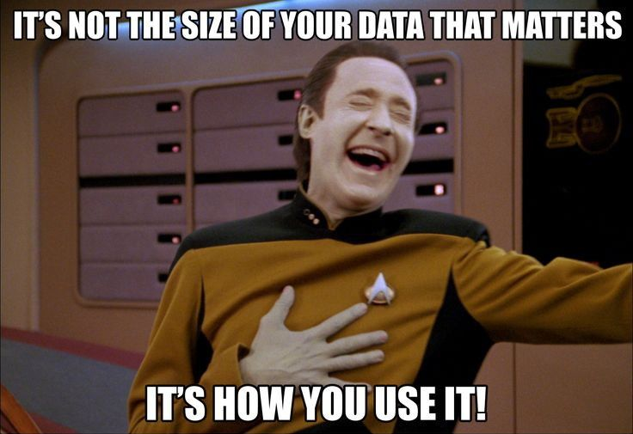
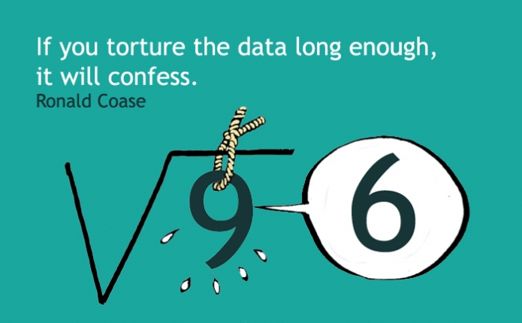
THANK YOU!!

